Slide 1
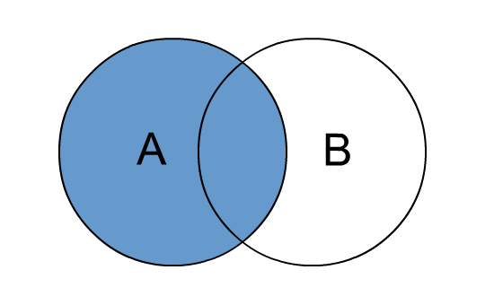
Left Join
It returns all the records which satisfy the condition (Table1.col_name = Table2.col_name) plus the records from the left table.

Slide 2
Example for Left Join
Order id | Customer id | Order details
1 | 1 | pizza
2 | 1 | coke
3 | 2 | burger
4 | 4 | Crispy chicken
Customer id | name | age
1 | sundar | 23
2 | asish | 21
3 | babar | 22

Slide 3
Resultant for the Left Join
Order id | Customer id | Order details | Customer id | name | age
1 | 1 | pizza | 1 | sundar | 23
2 | 1 | coke | 1 | sundar | 23
3 | 2 | burger | 2 | asish | 21
4 | 4 | Crispy chicken | NULL | NULL | NULL

Slide 4
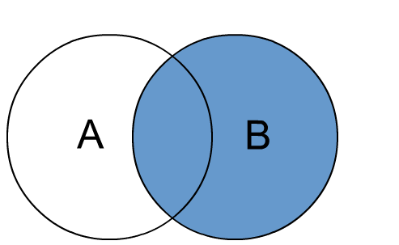
Right Join
It returns all the records which satisfy the condition (Table1.col_name = Table2.col_name) plus the records from the right table.

Slide 5
Example for Right Join
order_id | customer_id | order_details
1 | 1 | pizza
2 | 1 | coke
3 | 2 | burger
4 | 4 | Crispy chicken
customer_id | name | age
1 | sundar | 23
2 | asish | 21
3 | babar | 22

Slide 6
Resultant for the Right Join
Order id | Customer id | Order details | Customer id | name | age
1 | 1 | pizza | 1 | sundar | 23
2 | 1 | coke | 1 | sundar | 23
3 | 2 | burger | 2 | asish | 21
NULL | NULL | NULL | 3 | babar | 22

Slide 7
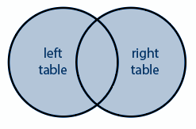
Full Outer Join
It returns all the records which satisfy the conditions plus the records from the left table as well as the right table

Slide 8
Example for Full Outer Join
Order id | Customer id | Order details
1 | 1 | pizza
2 | 1 | coke
3 | 2 | burger
4 | 4 | Crispy chicken
Customer id | name | age
1 | sundar | 23
2 | asish | 21
3 | babar | 22

Slide 9
Resultant for the Full Outer Join
Order id | Customer id | Order details | Customer id | name | age
1 | 1 | pizza | 1 | sundar | 23
2 | 1 | coke | 1 | sundar | 23
3 | 2 | burger | 2 | asish | 21
4 | 4 | Crispy chicken | NULL | NULL | NULL
NULL | NULL | NULL | 3 | babar | 22

